Slide 1
Advances in Genetics

Slide 2
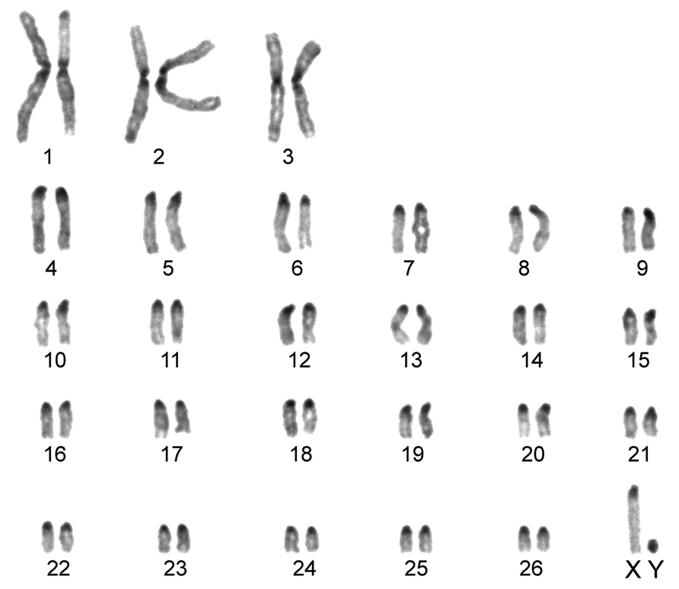
Karyotypes
A picture of all the chromosomes in a cell, arranged in pairs.

Slide 3
Selective Breeding
The Process of selecting organisms with the desired traits to be parents of the next generation.
Inbreeding: Crossing two individuals that have similar desired characteristics.
This increases the probability of genetic disorders.
Hybridization-crossing two genetically different individuals to get the best traits from both parents

Slide 4
Cloning
An exact reproduction that has the same genes as the original organism.
An example is an African Violet Start-cut stem and place back in soil, the new plant that starts will have the exact same genes in each cell as the original.
Animals are much more complex…the nucleus of a body cell is used to create a genetically identical organism.

Slide 5
Genetic Engineering
Genes from one organism are transferred into the DNA of another organism.
Plasmid- small circles of DNA in bacteria that can be inserted with some strands of human DNA so that the bacteria will produce a specific human protein. Insulin is a human example

Slide 6
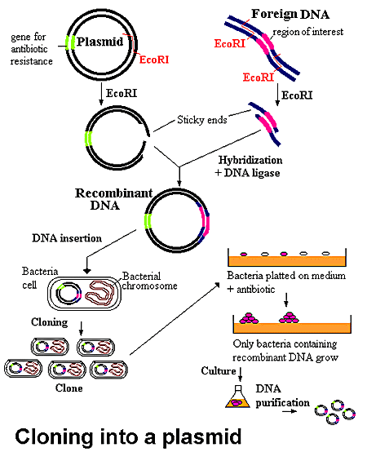

Slide 7
The Human Genome Project
A huge scientific endeavor to identify the DNA sequence of every gene in the human genome.
Genome-All the DNA in one cell of an organism.
There are 6 billion “letters” in the DNA code.
1st draft of the project- found more than 30,000 different genes in a human cell.
Genes have about an average of 3000 nitrogen bases per gene.

Slide 8
DNA Fingerprinting
Technology used to identify people and determine if people are related.
The DNA is broken into fragments and the pieces are analyzed and used to produce a pattern that becomes a “fingerprint” code.
No two are ever the same except for identical twins.

Slide 9
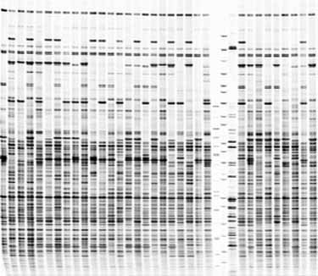
DNA Fingerprinting

Slide 10
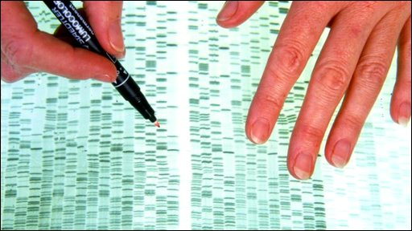
Comparing DNA

Slide 11
Bar Code Imaging

